Slide 1

NETWORK INTRUSION DETECTION SYSTEM USING MACHINE LEARNING
Under The Esteemed Guidance of
Mrs. Swarna Ramya
Assistant professor
Submitted by
P. Kiran Manogna
(20KT1A05A4)

Slide 2
Abstract
These days the services are available on the internet can easily get attacked using client server system.
To avoid Intrusion Detection attacks this model designed an automated neural network will be used.
IDS check request data and then check if it contains normal or attack signatures.
If it contains attack signatures, then IDS will drop that request and store such request data into a dataset for future detection purposes.
We design deep learning algorithm such as ANN and machine learning algorithm sucah as SVM and through experiment we conclude that ANN outperforms existing SVM, in terms of accuracy.
Using k selection feature selection algorithms to reduce dataset size, using this features selection algorithms size dataset will decrease and accuracy of prediction will increase.

Slide 3
Introduction
With the wide spreading usages of internet and increases in access to online contents, cybercrime is also happening at an increasing rate. Intrusion detection is the first step to prevent security attack. IDS detects attacks from a variety of systems and network sources by collecting information and then analyzes the information for possible security breaches. Till today anomaly-based detection is far behind than the detection that works based on signature and hence anomaly-based detection still remains a major area for research. The challenges with anomaly-based intrusion detection are that it needs to deal with novel attack for which there is no prior knowledge to identify the anomaly. The most widely used learning algorithm is SVM as it has already established itself on different types of problem. One major issue on anomaly-based detection is though all these proposed techniques can detect novel attacks but they all suffer a high false alarm rate in general. Today Artificial Neural Network (ANN) are often trained by the back propagation algorithm, which had been around since 1970 as the reverse mode of automatic differentiation.
The major challenges in evaluating performance of network IDS is the unavailability of a comprehensive network based data set. Most of the proposed anomaly-based techniques found in the literature were evaluated using KDD CUP 99 dataset. In this project we used SVM and ANN –two machine learning techniques, on NSL-KDD which is a popular benchmark dataset for network intrusion.

Slide 4
EXISTING SYSTEM
While network IDS that works based on signature have seen commercial success and widespread adoption by the technology-based organization throughout the globe, anomaly-based network IDS have not gained success on the same scale. Due to that reason in the field of IDS, currently, anomaly-based detection is a major focus area of research and development and before going to any wide-scale deployment of the anomaly-based intrusion detection system, key issues remain to be solved. But the literature today is limited when it comes to comparing how intrusion detection performs when using supervised machine learning techniques.
DISADVANTAGES OF EXISTING SYSTEM
• False Positives Signature-based threat detection is generally accurate, but when it comes to anomaly-based detection and identifying potentially suspicious or malicious activity you will likely encounter false positives.
• False Negatives On the other side of the spectrum from false positives, you also face a risk that suspicious or malicious activity will not be detected 100% of the time.
• This is particularly an issue with zero-day or emerging threats that rely on new exploits and attack techniques that the IDS is unfamiliar with.

Slide 5
PROPOSED SYSTEM
The promise and the contribution machine learning did till today are fascinating. There are many real-life applications we are using today offered by machine learning. It seems that machine learning will rule the world in the coming days. Hence, we came out with a hypothesis that the challenge of identifying new attacks or zero-day attacks faced by the technology-enabled organizations today can be overcome using machine learning techniques. Here we developed a supervised machine learning model that can classify unseen network traffic based on what is learned from the seen traffic. We use customized ANN compared with SVM algorithm to find the best classifier with higher accuracy and success rate

Slide 6
Table 1: Overview on Network Intrusion Detection System
S.No | Author Name | Algorithm | Advantages | Disadvantages
1. | Mubarak Albarka Umar er.al.. | ● Decision Tree | ❖ A decision tree does not require normalization of data. ❖ A decision tree does not require scaling of data as well | ❖ Sometimes calculation can go far more complex compared to other algorithms. ❖ A small change in the data can cause a large change in the structure of the decision tree causing instability.
2. | Zeeshan Ahmad et.al | ●Least Square Support Vector Machine | ❖It is more effective in high dimensional spaces. ❖It is relatively memory efficient | ❖This algorithm is not suitable for large data sets. ❖The data set has more noise i.e. target classes are overlapping.
3. | Emad. Abdall ah et.al. | ● Naive Bayes classifier | ❖Gives better results for relatively larger datasets, works quickly and can save a lot of time. | ❖Implicitly assumes that all the attributes are mutually independent and sometimes result zero frequency.

Slide 7
4. | Nidhi Kumari et.al | ●Least Square Support Vector Machine | ❖LS-SVM presents faster convergence. | ❖Difficulty with big data, increase runtime and memory requirements.
5. | Hafiza Anisa Ahmed | ●Random Forest | ❖ It does not suffer from the over fitting problem. ❖Accurate, efficiency and Reliable algorithm | ❖Better Performance is obtained with more Parameters for various algorithms.
6. | Yasmeen S. Almutairi et .al. | ●Random Forest ●Navie Bayies | ❖It prevents overfitting and is more accurate in prediction. ❖It handles both continuous and discrete data | ❖A large number of trees can make the algorithm too slow ❖It has trouble with the zero frequency problem
7. | Venkata Ramani Varanasi et.al | ●SVM (Support Vector Machine) | ❖It is having ability high dimensional data | ❖It doesn't applicable for large data sets

Slide 8
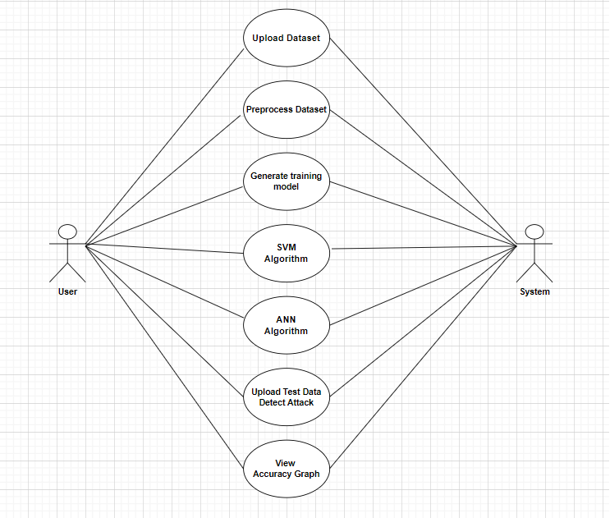
USECASE DIAGRAM
FIG 1: USECASE DIAGRAM

Slide 9
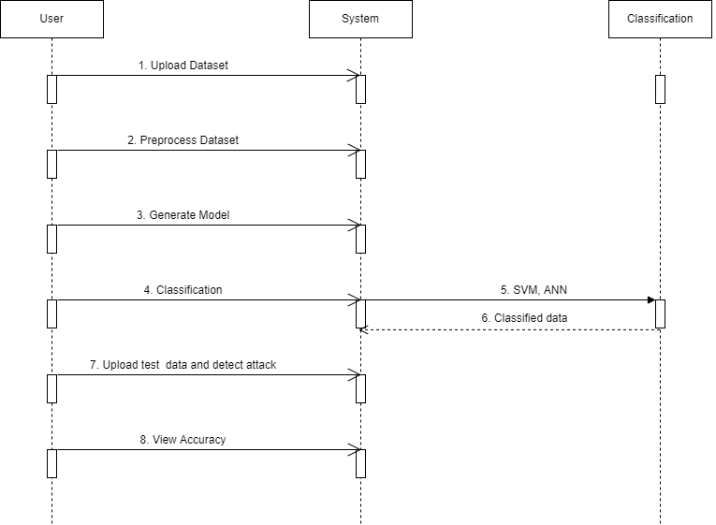
SEQUENCE DIAGRAM
FIG 2: SEQUENCE DIAGRAM

Slide 10
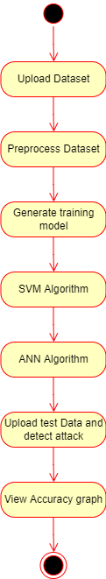
ACTIVITY DIAGRAM
FIG 3: ACTIVITY DIAGRAM

Slide 11
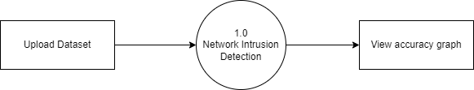
DATAFLOW DIAGRAMS :
LEVEL 0
FIG 4: DATAFLOW DIAGRAM LEVEL 0

Slide 12
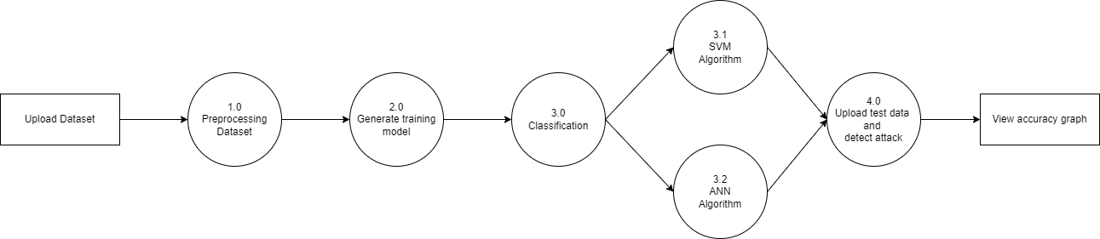
LEVEL 1
FIG 5: DATAFLOW DIAGRAM LEVEL 1

Slide 13
Sample Code
from tkinter import messagebox from tkinter
import * from tkinter import simpledialog
import tkinter from tkinter
import filedialog from imutils
import paths
import matplotlib.pyplot as plt
import numpy as np from tkinter.filedialog
import askopenfilename
import numpy as np
import pandas as pd from sklearn import * from sklearn.model_selection
import train_test_split from sklearn
import svm from sklearn.metrics
import accuracy_score from sklearn.feature_selection

Slide 14
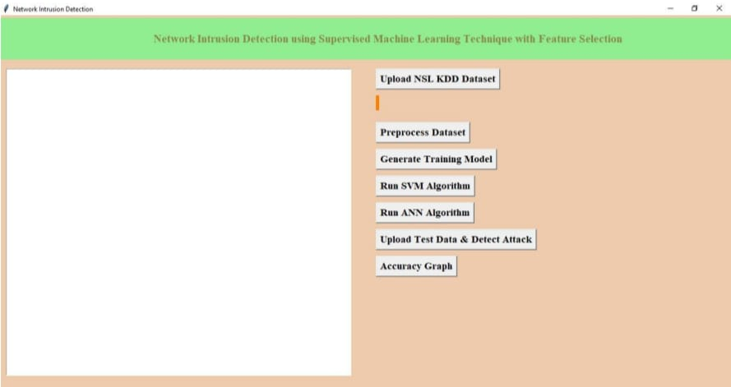
OUTPUT:
SCR 10.1: HOME SCREEN
In above screen click on ‘Upload NSL KDD Dataset’ button and upload dataset

Slide 15
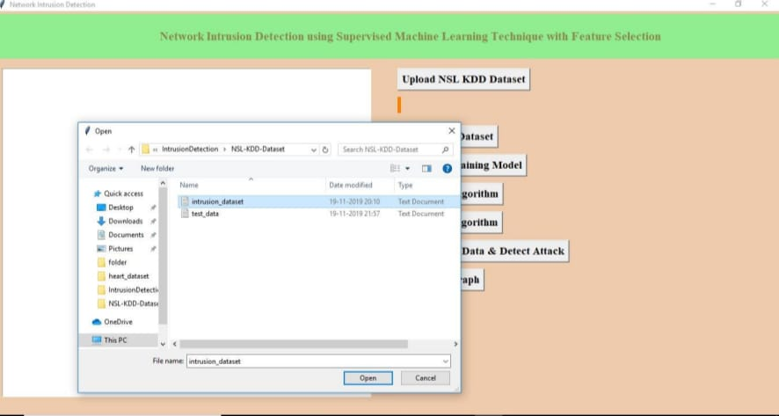
SCR 10.2: UPLOAD DATASET
In above screen I am uploading ‘intrusion_dataset.txt’ file, after uploading dataset will get below screen

Slide 16
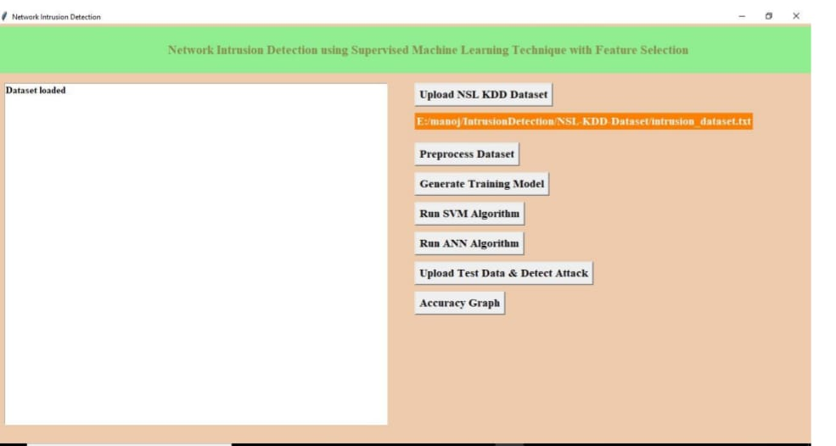
SCR 10.3: UPLOADED DATASET

Slide 17
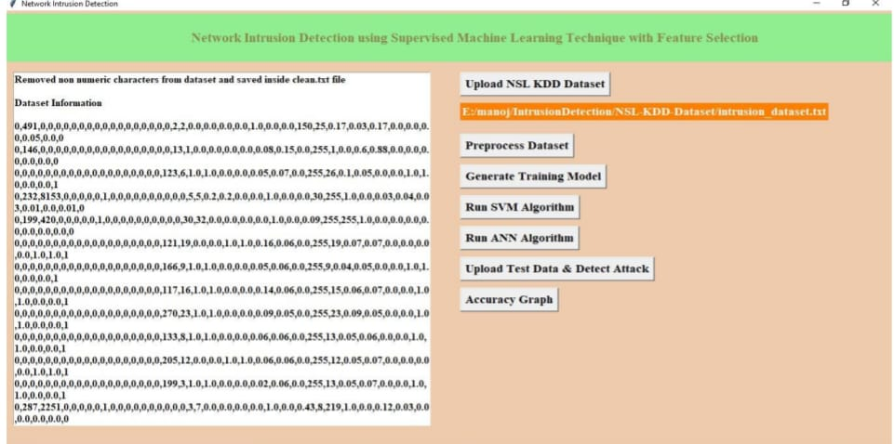
Now click on ‘Pre-process Dataset’ button to clean dataset to remove string values from dataset and to convert attack names to numeric values
SCR 10.4: PREPROCESSING THE DATA
After pre-processing all string values removed and convert string attack names to numeric values such as normal signature contains id 0 and anomaly attack contains signature id 1.

Slide 18
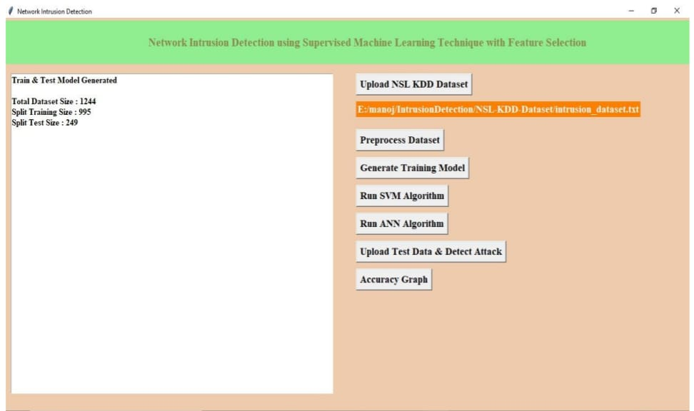
Now click on ‘Generate Training Model’ to split train and test data to generate model for prediction using SVM and ANN.
SCR 10.5: GENERATING TRAINING MODEL
In above screen we can see dataset contains total 1244 records and 995 used for training and 249 used for testing.

Slide 19
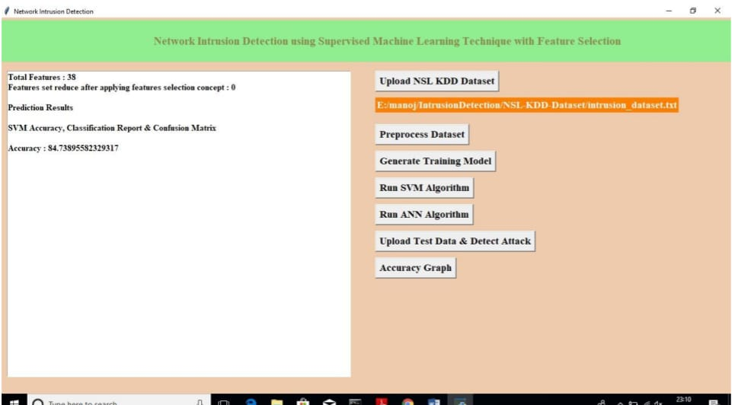
Now click on ‘Run SVM Algorithm’ to generate SVM model and calculate its model accuracy.
SCR 10.6: RUN SVM ALGORITHM
In above screen we can see with SVM we got 84.73% accuracy, now click on ‘Run ANN Algorithm’ to calculate ANN accuracy

Slide 20
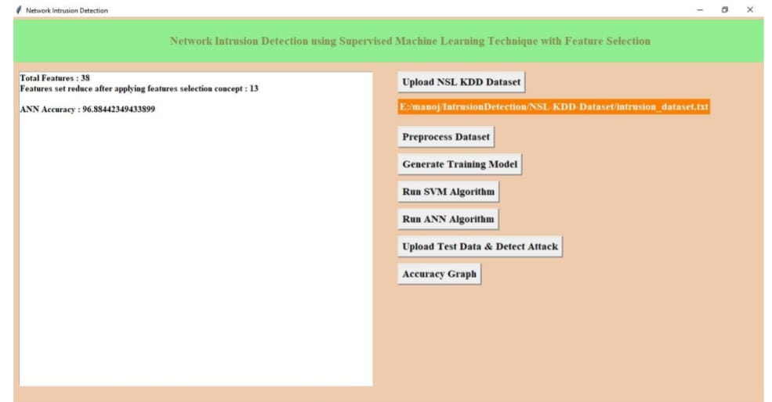
SCR 10.7: RUN ANN ALGORITHM
In above screen we got 96.88% accuracy, now we will click on ‘Upload Test Data & Detect Attack’ button to upload test data and to predict whether test data is normal or contains attack. All test data has no class either 0 or 1 and application will predict and give us result.

Slide 21
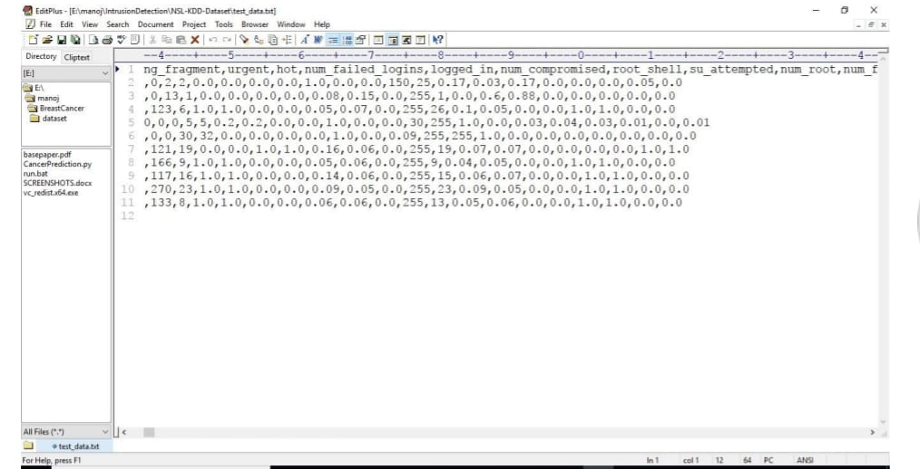
See below some records from test data
SCR 10.8: TEST DATA
In above test data we don’t have either ‘0’ or ‘1’ and application will detect and give us result.

Slide 22
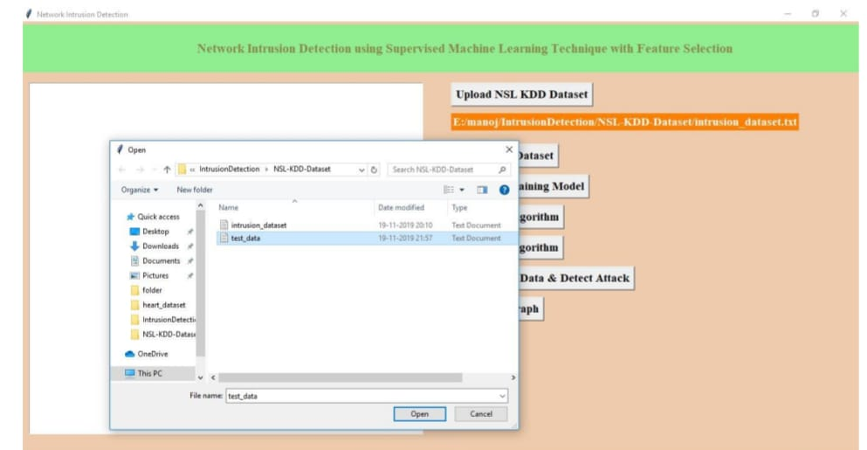
SCR 10.9: UPLOADING TEST DATA
In above screen I am uploading ‘test data’ file which contains test record, after prediction will get below results

Slide 23
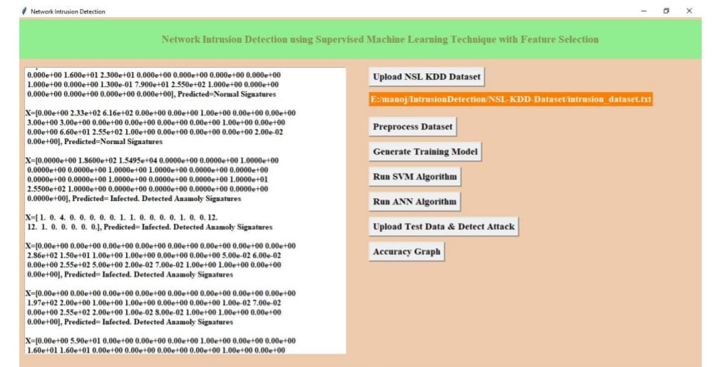
SCR 10.10: DETECTING ATTACKS
In above screen for each test data we got predicted results as ‘Normal Signatures’ or
‘infected’ record for each test record. Now click on ‘Accuracy Graph’ button to see SVM and ANN accuracy comparison in graph format.

Slide 24
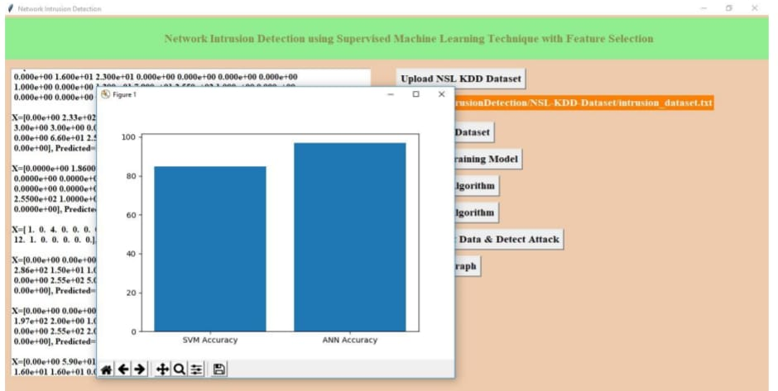
SCR 10.11: ACCURACY GRAPH
From above graph we can see ANN got better accuracy compare to SVM, in above graph xaxis contains algorithm name and y-axis represents accuracy of that algorithms.

Slide 25
Conclusion
In this project, we are using Machine Learning algorithms and feature selection algorithms. Till now many of the system uses Signature based technique to find the now attacks only so we choose Anomaly based technique to find the unknown attacks. Till now this technique is a research topic due to high false positive rate of the existing system.

Slide 26
References
Varanasi, V., & Razia, S. (2022). Network Intrusion Detection using Machine Learning, Deep Learning - A Review. In 2022 4th International Conference on Smart Systems and Inventive Technology (ICSSIT). 2022 4th International Conference on Smart Systems and Inventive Technology (ICSSIT). IEEE. https://doi.org/10.1109/icssit53264.2022.9716469.
Ahmad, Z., Shahid Khan, A., Wai Shiang, C., Abdullah, J., & Ahmad, F. (2020). Network intrusion detection system: A systematic study of machine learning and deep learning approaches. In Transactions on Emerging Telecommunications Technologies (Vol. 32, Issue 1). Wiley. https://doi.org/10.1002/ett.4150.
Abdallah, E. E., Eleisah, W., & Otoom, A. F. (2022). Intrusion Detection Systems using Supervised Machine Learning Techniques: A survey. In Procedia Computer Science (Vol. 201, pp. 205–212). Elsevier BV. https://doi.org/10.1016/j.procs.2022.03.029.
Ahmed, H. A., Hameed, A., & Bawany, N. Z. (2022). Network intrusion detection using oversampling technique and machine learning algorithms. In PeerJ Computer Science (Vol. 8, p. e820). PeerJ. https://doi.org/10.7717/peerj-cs.820.
Kumari, N. (2022). Intrusion Detection System Using Machine Learning: An Overview. Unpublished. https://doi.org/10.13140/RG.2.2.20109.41441.
Hafiza Anisa Ahmed, Anum Hameed and Narmeen Zakaria Bawany Department of Computer Science and Software Engineering, Jinnah University for Women, Karachi, Sindh, Pakistan

Slide 27
EXECUTION VIDEO
https://drive.google.com/drive/folders/1H3mePIzY2TBnA8zLfDXUWKhyLE9Uezlw

Slide 28
THANK YOU

